Slide 1
RHETORICAL/STYLISTIC DEVICES

Slide 2
REPETITION
AT THE BEGINNING: “We shall go on to the end, we shall fight in France, we shall fight on the seas and oceans…”
AT THE END: “The cars do not sell because the engineering is inferior, the quality of materials is inferior, and the workmanship is inferior.”
THROUGHOUT: It may just be that a writer repeats a certain word/phrase throughout the entirety of the speech. For instance, news outlets have noted how many times President Trump references “fake news” in his recent speeches as he tries to downplay the Mueller investigation and other hot-topic issues.

Slide 3
IMAGERY
What kind of imagery? Sight? Sound? Smell? Taste? Touch?
Recall the President Carter piece on preserving the Arctic; he includes nature imagery: landscape and animals
SIGHT: “…brilliant mosaic of wildflowers, mosses, and lichen that hugged the tundra.”
SOUND: “…the sweep of tundra before us became flooded with life, with the sounds of grunting animals and clicking hooves filling the air.”
*Remember that these images were employed to elicit appreciation from the audience so that they could understand the damage to wildlife if industrialization were to occur.

Slide 4
DEVICES of COMPARISON
Simile
Metaphor
Analogy
Juxtaposition

Slide 5
SIMILE
Compares two things using “like” or “as”
Trying to navigate the complicated process of college applications is like being lost in a labyrinth.

Slide 6
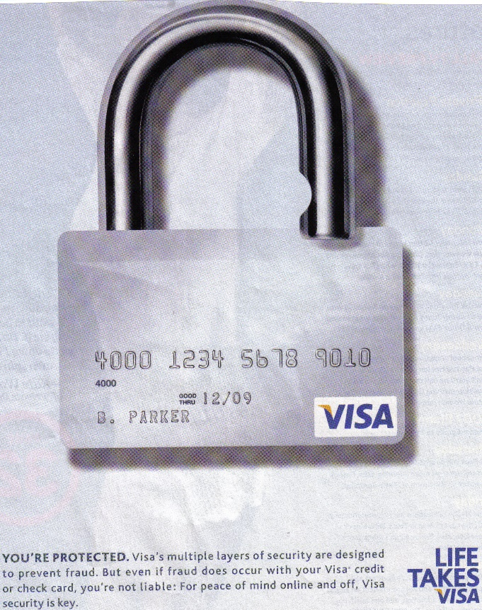
METAPHOR
Makes a comparison without “like” or “as”
Ex: The blank paper is the dawning of a new day for any writer.→the blank paper is compared to a new day to suggest a fresh start or opportunity.
The ad at right suggests that a Visa is a lock; it protects one’s purchases and identity.

Slide 7
ANALOGY
An analogy makes a comparison between two things (with or without like or as)
EXAMPLE: Including warning labels on music with explicit lyrics is the same as the MPAA ratings system; both alert consumers to potentially offensive material.

Slide 8
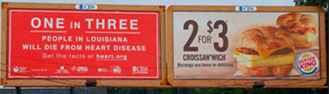
JUXTAPOSITION
Places two things/concepts next to each other for comparison/contrast
“With this faith we will be able to transform the jangling discords of our nation into a beautiful symphony of brotherhood.” (MLK—what is vs. what can be, thereby offering hope for future)

Slide 9
DICTION—but what kind?!
Are the words related to…defeat? Triumph? Pain? Hope? Longing?
EXAMPLE: Oprah’s speech at the Golden Globes: “So I want all the girls watching here and now to know that a new day is on the horizon! And when that new day finally dawns, it will be because of a lot of magnificent women, many of whom are right here in this room tonight, and some pretty phenomenal men, are fighting hard to make sure that they become the leaders who take us to the time when nobody ever has to say “me too” again. Thank you.”
DICTION: Hope, triumph→In her Golden Globes speech, Oprah Winfrey employs hopeful diction in order to reassure her audience that equality is possible.

Slide 10
MISCELLANEOUS
Punctuation
Tense
POV
Sentence structures (commands, questions…)
Other devices: hyperbole, allusion, etc.

